Slide 1

cat beag dubh cat beag dubh
1,2,3
Notes:
A little, black cat x2
1,2,3

Slide 2
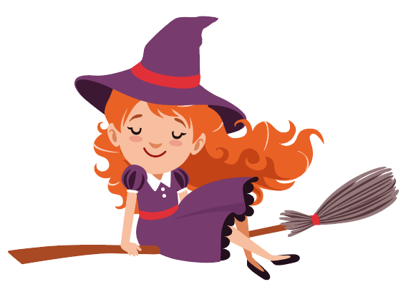
bana-bhuidseach bana-bhuidseach
Leum, leum, uì!
Notes:
A witch x2
Jump, jump, weeee!

Slide 3
caisteal mòr caisteal mòr
1,2,3
Notes:
A big castle x2
1,2,3

Slide 4
ialtag bheag ialtag bheag
Leum, leum, uì!
Notes:
A little bat x2
Jump, jump, weeee!

Slide 5
peapag orains peapag orains
1,2,3
Notes:
An orange pumpkin X2
1,2,3

Slide 6
damhan-allaidh damhan-allaidh
Leum, leum, uì!
Notes:
A spider X2
Jump, jump, weeeee!

